Slide 1

FOREIGN LANGUAGE
UPC07
Unit 11

Slide 2

UNIT 11
LIFE´S LITTLE LESSONS
Lic. Milton Ocando Álvarez

Slide 3

LEARNING OUTCOMES
Understand information and questions with describing rites of passages; describing turning points
Make statements and questions.
Understand short and long descriptions.

Slide 4
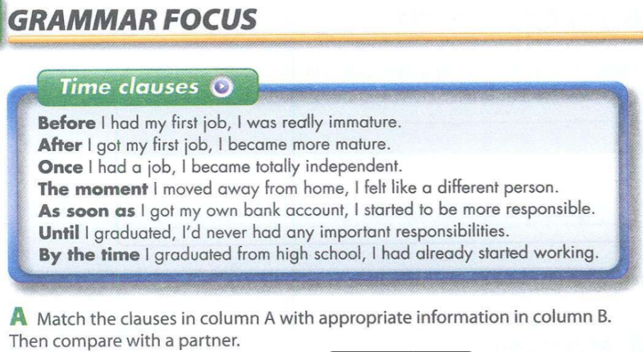

Slide 5
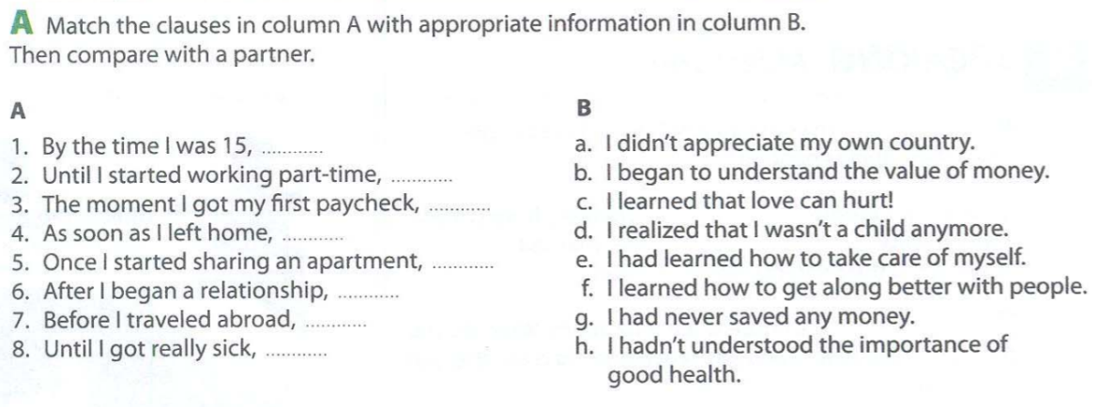

Slide 6
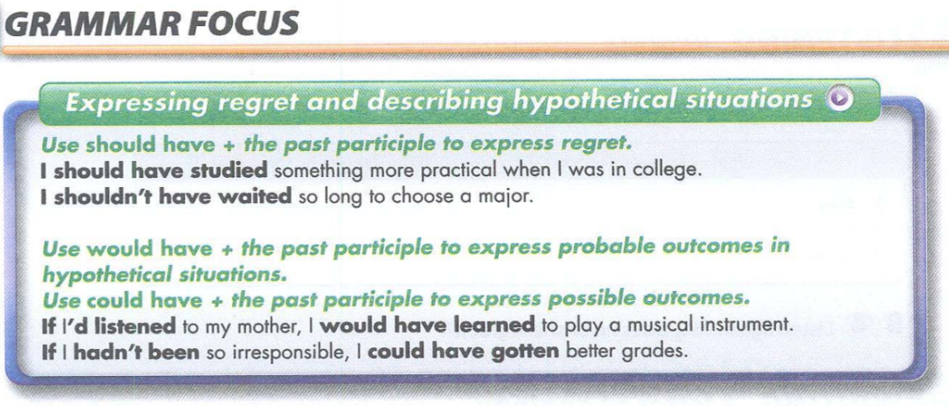

Slide 7
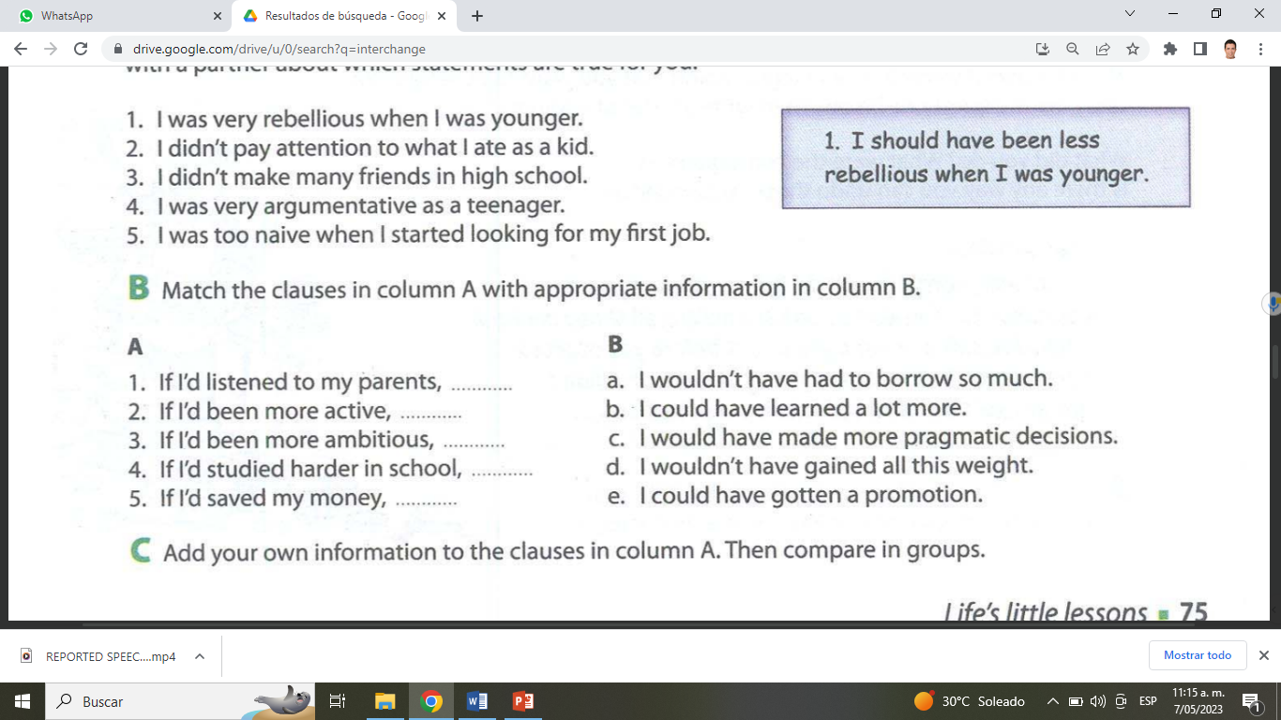

Slide 8
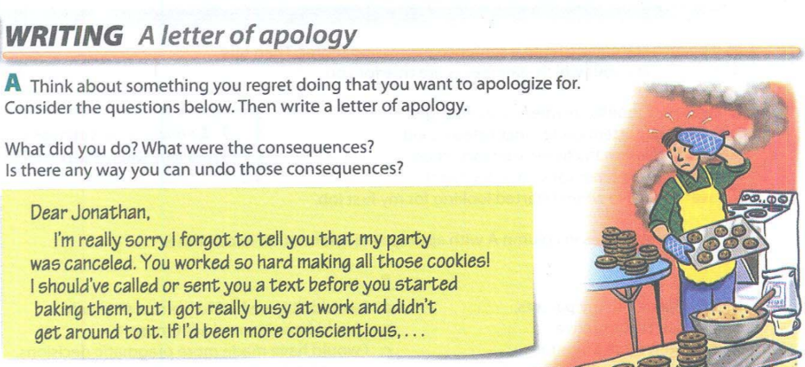
Task: A letter

Slide 9

References
https://www.freepik.es/
Wilson, Ken (2016). Smart Choice 1 3rd Edition. Oxford University Press.
Para mayor información sigue el enlace

Slide 10


